Slide 1

Operation & Metric Analytics
PROJECT-3

Slide 2
Project Description :-
This project involved using MySQL to analyze operational data and investigate metric spikes. The aim was to generate insights and answer queries related to the organization's operations.
CASE STUDY 01:
Number of jobs reviewed: Amount of jobs reviewed over time. Your task: Calculate the number of jobs reviewed per hour per day for November 2020?
Throughput: It is the no. of events happening per second. Your task: Let’s say the above metric is called throughput. Calculate 7 day rolling average of throughput? For throughput, do you prefer daily metric or 7-day rolling and why?
Percentage share of each language: Share of each language for different contents. Your task: Calculate the percentage share of each language in the last 30 days?
Duplicate rows: Rows that have the same value present in them. Your task: Let’s say you see some duplicate rows in the data. How will you display duplicates from the table?

Slide 3
CASE STUDY 2:
A. User Engagement: To measure the activeness of a user. Measuring if the user finds quality in a product/service. Your task: Calculate the weekly user engagement?
B. User Growth: Amount of users growing over time for a product. Your task: Calculate the user growth for product?
C. Weekly Retention: Users getting retained weekly after signing-up for a product. Your task: Calculate the weekly retention of users-sign up cohort?
D. Weekly Engagement: To measure the activeness of a user. Measuring if the user finds quality in a product/service weekly. Your task: Calculate the weekly engagement per device?
E. Email Engagement: Users engaging with the email service. Your task: Calculate the email engagement metrics?

Slide 4
Approach:
Use SQL to create a database that can store the data and support the queries that we need to perform the analysis and load the data into the database. Use SQL queries to perform the analysis and retrieve the insights you want to extract.
Tech-Stack Used :
MySQL Workbench 8.0 CE
Insights:
The queries were performed and recorded the observations based on the questions that were asked and the followings were results.

Slide 5
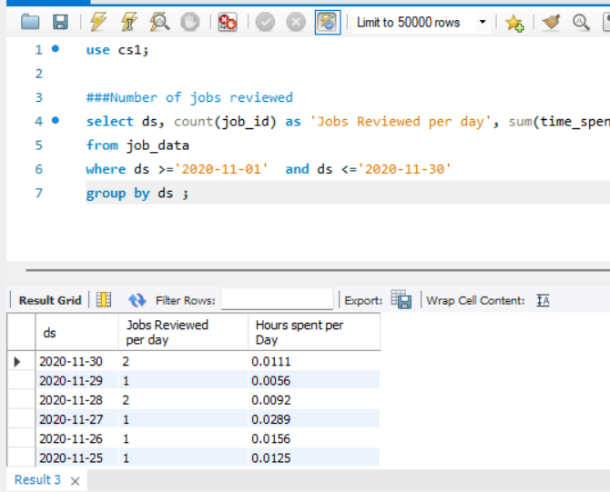
Case Study 1 (Job Data)
1.Number of jobs reviewed:

Slide 6
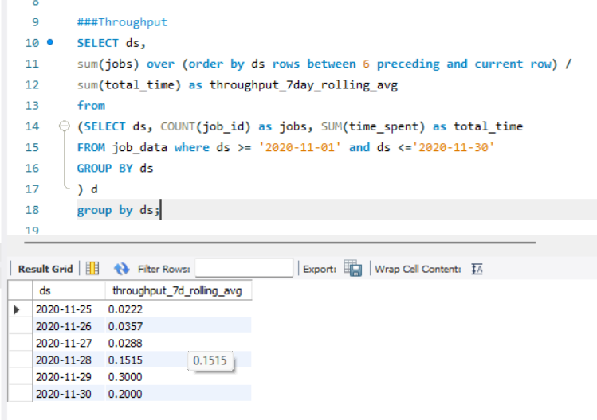
2.Throughput:

Slide 7
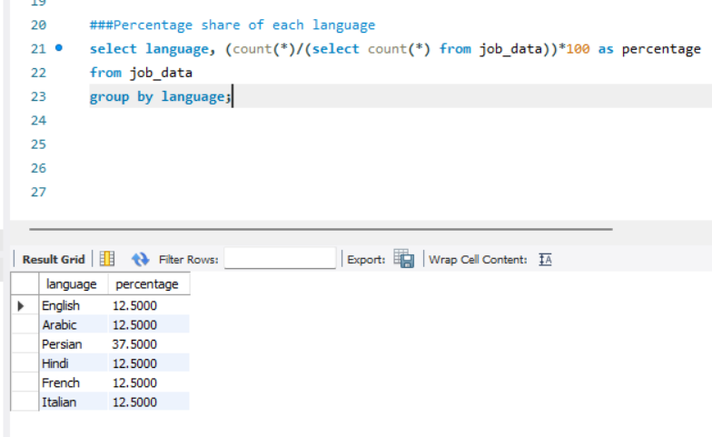
3.Percentage share of each language:

Slide 8
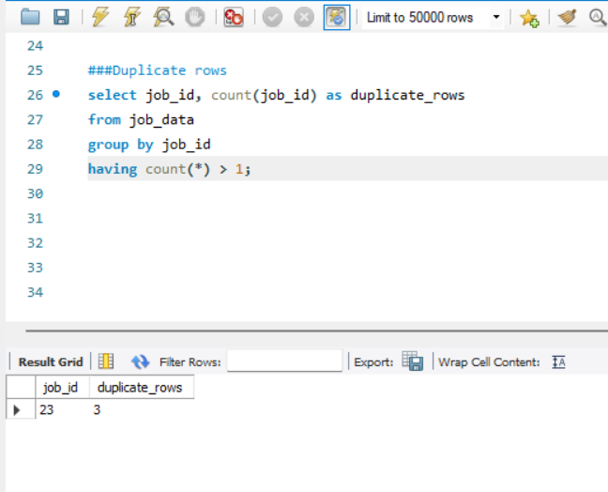
4.Duplicate rows:

Slide 9
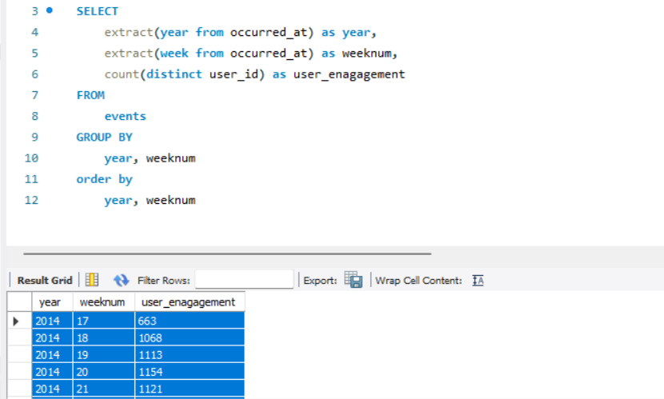
Case Study 2 (Investigating metric spike)
1.User Engagement:

Slide 10
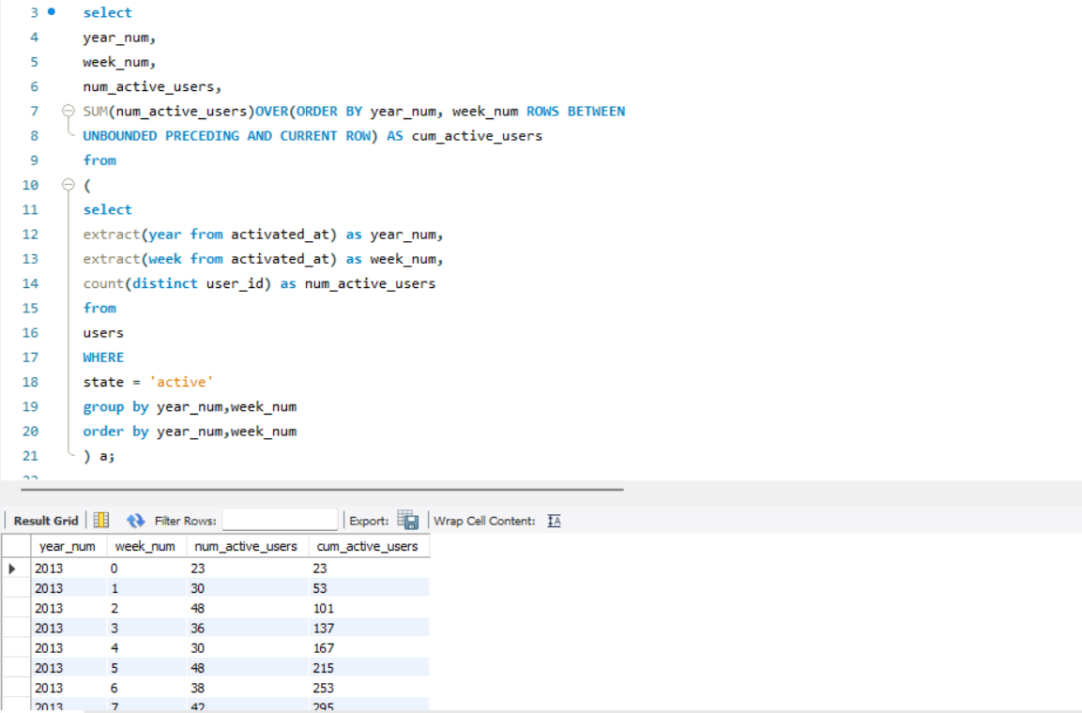
2.User Growth:

Slide 11
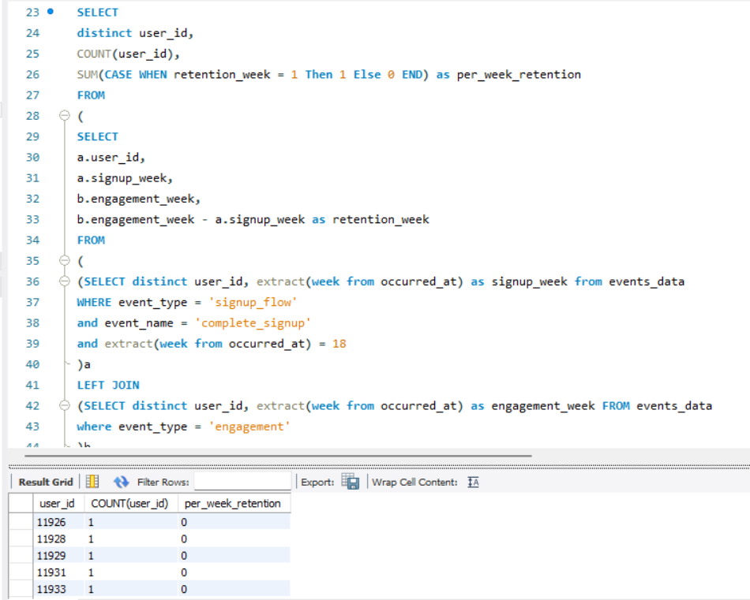
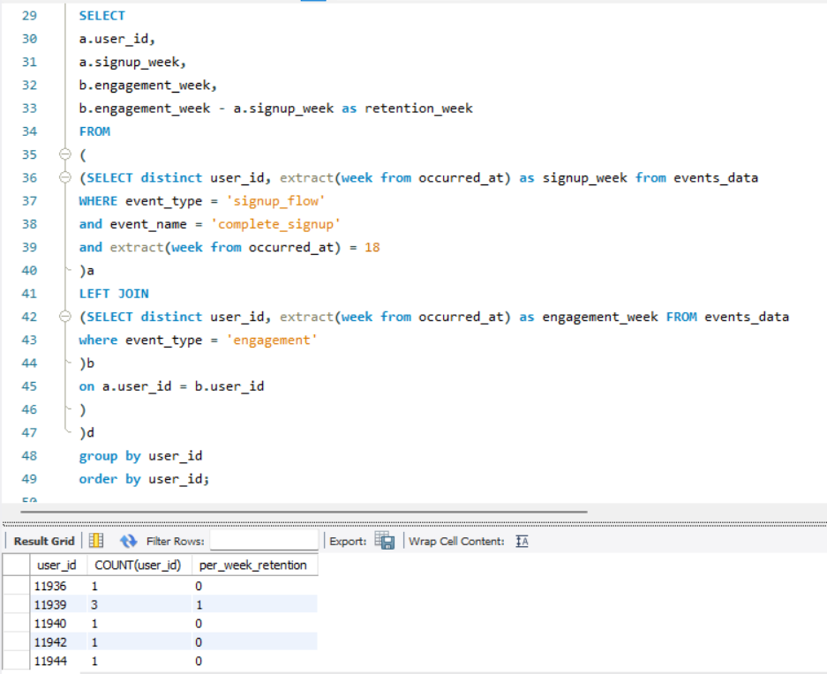
3.Weekly Retention:

Slide 12
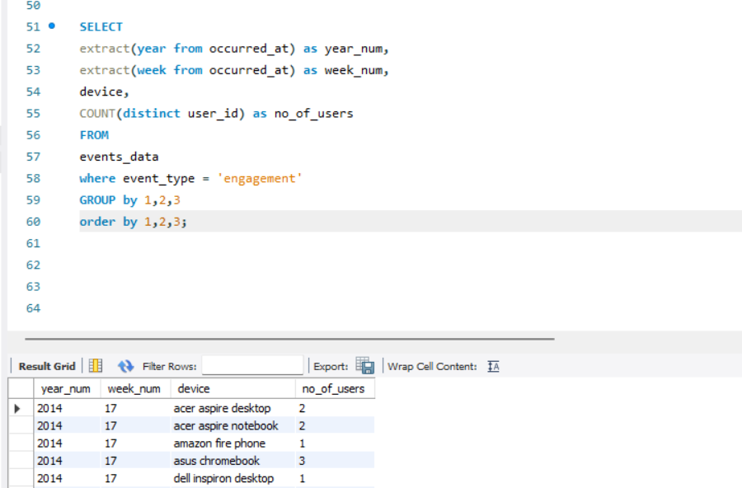
4.Weekly Engagement:

Slide 13
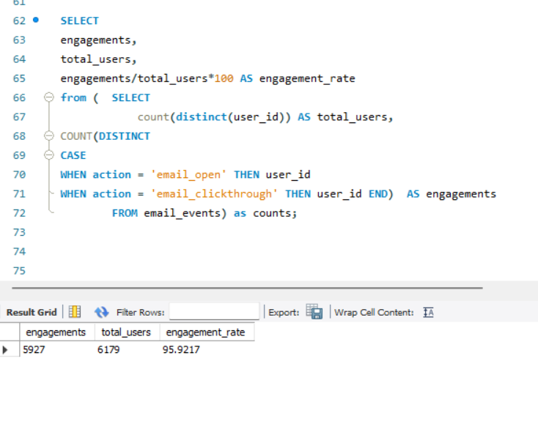
5.Email Engagement:

Slide 14
Result :
Extracted many useful analysis that could help in making data driven decisions making for the business.
In this task, I have many basics as well as advanced concepts related to SQL and this project helped me to understand those concepts experimentally.
All the tables and data that were extracted where attached in the following sheet:

